Slide 1
Predicting the Length of an LLM Answer
from the Prompt
Can the prompt tell us how long the answer will be?
Gal Mund · 322544297 Nadav Grossman · 315111880
CS Workshop · Tel Aviv University · September 2026
CS Workshop · Tel Aviv University · Gal Mund & Nadav Grossman
1 / 16
Notes:
Read the title, then the question. ~15 seconds.

Slide 2
01 · MOTIVATION
Can we predict answer length from the prompt alone?
We see the prompt
Not the answer, and not the model’s hidden state.
Length varies a lot
Tens of tokens for one request, thousands for the next.
Is the signal in the text?
If it is, a small encoder should beat chance.
CS Workshop · Tel Aviv University · Gal Mund & Nadav Grossman
2 / 16
Notes:
Curiosity only. Same model, different prompts, very different lengths. Can a classifier read that off the prompt? ~40 seconds.

Slide 3
01 · MOTIVATION
We predict a range, not an exact count
Exact token counts are noisy — sampling changes them.
Four equal-sized buckets. Prompt length alone is a weak cue (r = 0.10).
Short
Medium
Long
Very long
0 – 229
230 – 418
419 – 592
593+
mean 90 tokens
mean 338 tokens
mean 496 tokens
mean 867 tokens
Later, the cloud model splits the same range into eight octiles.
CS Workshop · Tel Aviv University · Gal Mund & Nadav Grossman
3 / 16
Notes:
Buckets, not exact counts. Point at Short vs Very long. Mention r = 0.10 so they expect a learned model, not a length rule. ~40 seconds.

Slide 4
01 · MOTIVATION
Related work
Ask the LLM
Encoder buckets
Zheng et al., 2023
S³ · SSJF · Arango et al.
The answering model guesses its own length first.
A small encoder predicts buckets or a token count.
Update while decoding
This work
TRAIL, 2025
Prompt only
The prediction is refined after each generated token.
Four or eight buckets from the prompt. Nothing is generated first.
CS Workshop · Tel Aviv University · Gal Mund & Nadav Grossman
4 / 16
Notes:
We sit with the encoder-bucket papers. Ours uses only the prompt. ~40 seconds.

Slide 5
02 · METHOD
How we ran the experiment
01 Download
02 Filter
03 Label
04 Split
WildChat-1M
English, single-turn
Answer token count
70 / 15 / 15
Local · DistilBERT
Cloud · ModernBERT-large
66M parameters · 256-token context
4 buckets · Apple M4 Pro
395M parameters · 2,048-token context
8 buckets · NVIDIA L40S
Same 210k training prompts. Same 45k test set. Two classifiers.
CS Workshop · Tel Aviv University · Gal Mund & Nadav Grossman
5 / 16
Notes:
Data once, then local 4-way vs cloud 8-way on the same split. ~40 seconds.

Slide 6
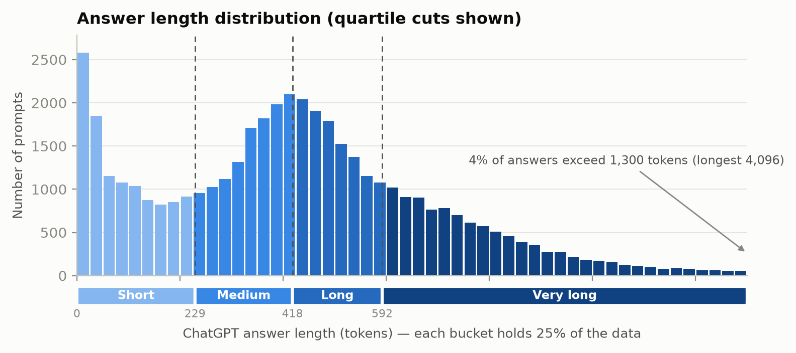
02 · METHOD
300,000 real ChatGPT conversations
300,000
English, single-turn
WildChat examples
70 / 15 / 15
Train / val / test
210k · 45k · 45k
r = 0.10
Prompt vs answer length
(0.34 on log counts)
SHORT
MEDIUM
LONG
VERY LONG
“Create image with Cursed Refaund”
“how to make my music sound more 80s”
“Problems of integration of ICT in school”
“Type an essay on Singapore for me”
answer · 18 tokens
answer · 281 tokens
answer · 497 tokens
answer · 785 tokens
CS Workshop · Tel Aviv University · Gal Mund & Nadav Grossman
6 / 16
Notes:
Real ChatGPT logs. Prompt length barely predicts answer length. Read Short vs Very long. ~50 seconds.

Slide 7
03 · LOCAL
DistilBERT, trained locally
ENCODER
SIZE
DistilBERT-base-uncased
66 million parameters
CONTEXT
HEAD
256 tokens, truncated
4-way classifier, cross-entropy
MACHINE
OPTIMISER
Apple M4 Pro, batch 32
AdamW, 2×10⁻⁵, 10% warmup
SCHEDULE
BASELINES
≤6 epochs, early stop on val macro-F1
Chance (25%) and prompt-length rule
CS Workshop · Tel Aviv University · Gal Mund & Nadav Grossman
7 / 16
Notes:
Small encoder, laptop, four buckets. ~30 seconds.

Slide 8
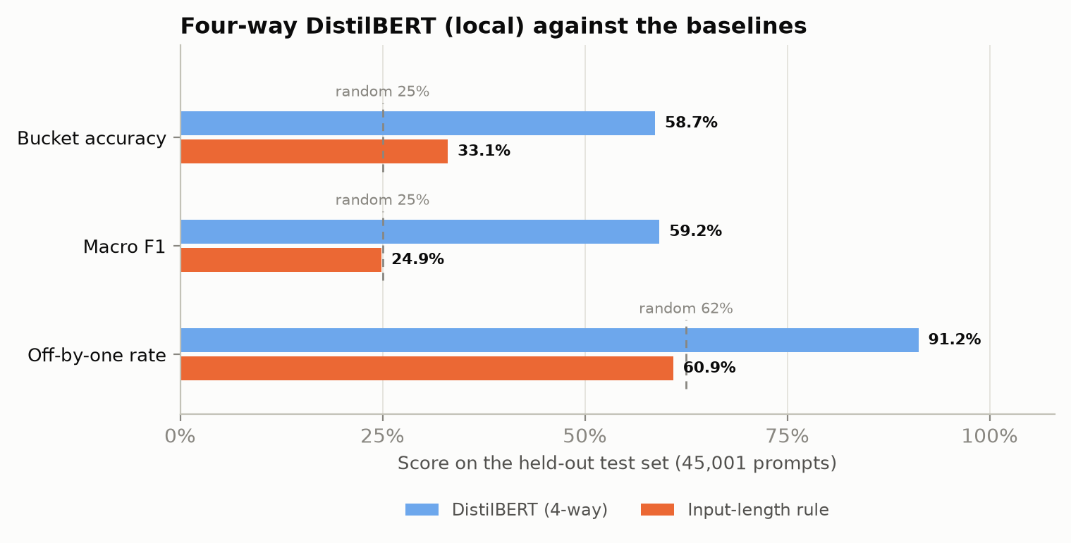
03 · LOCAL
Well above chance, and above prompt length
58.7%
91.2%
2.35×
accuracy · chance 25%
within one bucket
chance · rule 33.1%
CS Workshop · Tel Aviv University · Gal Mund & Nadav Grossman
8 / 16
Notes:
58.7% vs 25%. The length rule is only 33%. ~45 seconds.

Slide 9
04 · CLOUD
Larger encoder, longer prompts, finer buckets
01 Longer prompts
AWS · TAU
51% of prompts exceed 256 tokens. ModernBERT reads 2,048.
g6e.xlarge
NVIDIA L40S, 48 GB
eu-north-1
Train 4-way, then 8-way
Copy home, terminate
02 Larger encoder
ModernBERT-large, 395M parameters, bf16 on an L40S.
03 Finer buckets
Eight octiles instead of four quartiles.
Four-way ModernBERT is 60.3%, close to DistilBERT’s 58.7%. We keep the eight-way head for finer labels, not a higher 4-way score.
CS Workshop · Tel Aviv University · Gal Mund & Nadav Grossman
9 / 16
Notes:
Why cloud: context, size, 8 classes. Do not compare 58.7% to 43.4%. ~40 seconds.

Slide 10
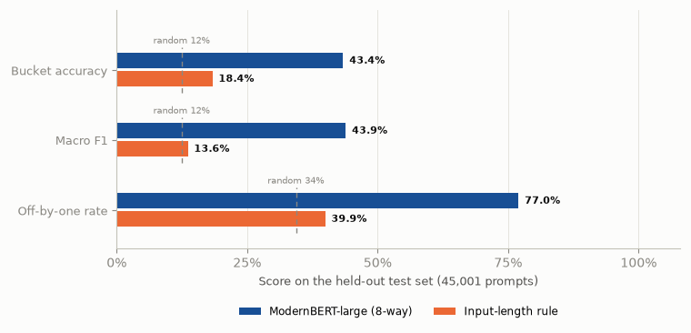
04 · CLOUD
Harder task, still far above chance
43.4%
77.0%
3.47×
accuracy · chance 12.5%
within one bucket
chance · rule 18.4%
CS Workshop · Tel Aviv University · Gal Mund & Nadav Grossman
10 / 16
Notes:
Chance is 12.5% here. Do not compare to 58.7%. ~40 seconds.

Slide 11
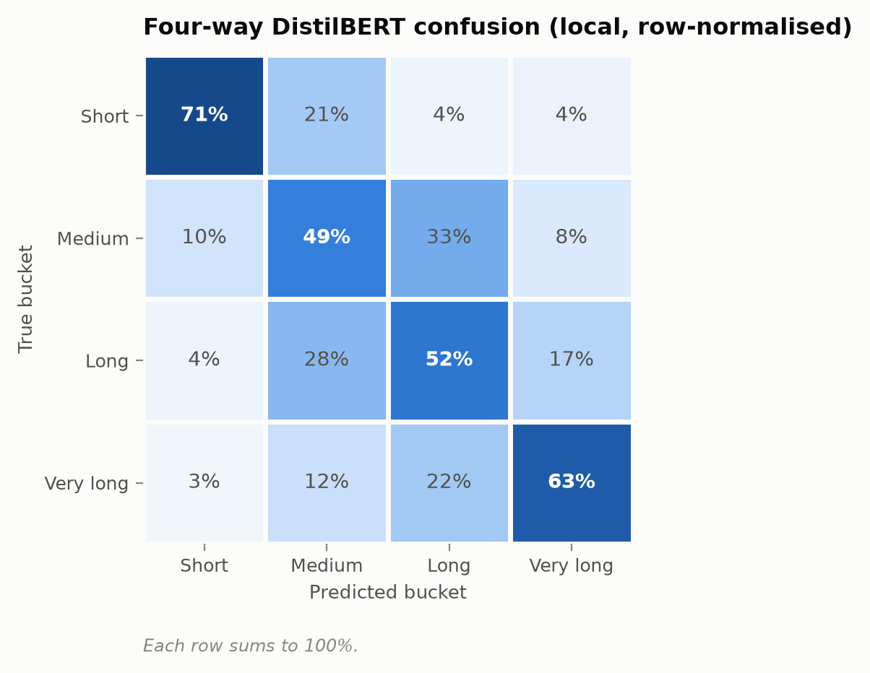
RESULTS
Most mistakes are neighbours
71% / 63%
Short and Very long are easiest.
~50%
The middle two buckets are harder.
3–4%
Almost never swaps Short with Very long.
Off by one
Common. Off by three is rare.
CS Workshop · Tel Aviv University · Gal Mund & Nadav Grossman
11 / 16
Notes:
Diagonal, then the 3–4% far errors. ~35 seconds.

Slide 12
05 · APPLICATION
One use of the signal: order a queue
If job size is known, shortest-first cuts average wait. We use the predicted bucket as the size.
FCFS
Shortest prompt
DistilBERT
ModernBERT
Oracle
Arrival order
Weak proxy
4 priorities
8 priorities
True lengths
QUEUE
SERVICE
M/G/1, one server, no preemption.
0.5 s + 1 s per 50 tokens. Mean 9.45 s.
LOAD
RUNS
ρ = 0.90.
10 × 200k requests. Same arrivals, different order.
CS Workshop · Tel Aviv University · Gal Mund & Nadav Grossman
12 / 16
Notes:
Application, not motivation. Simulation, not a live cluster. ~40 seconds.

Slide 13
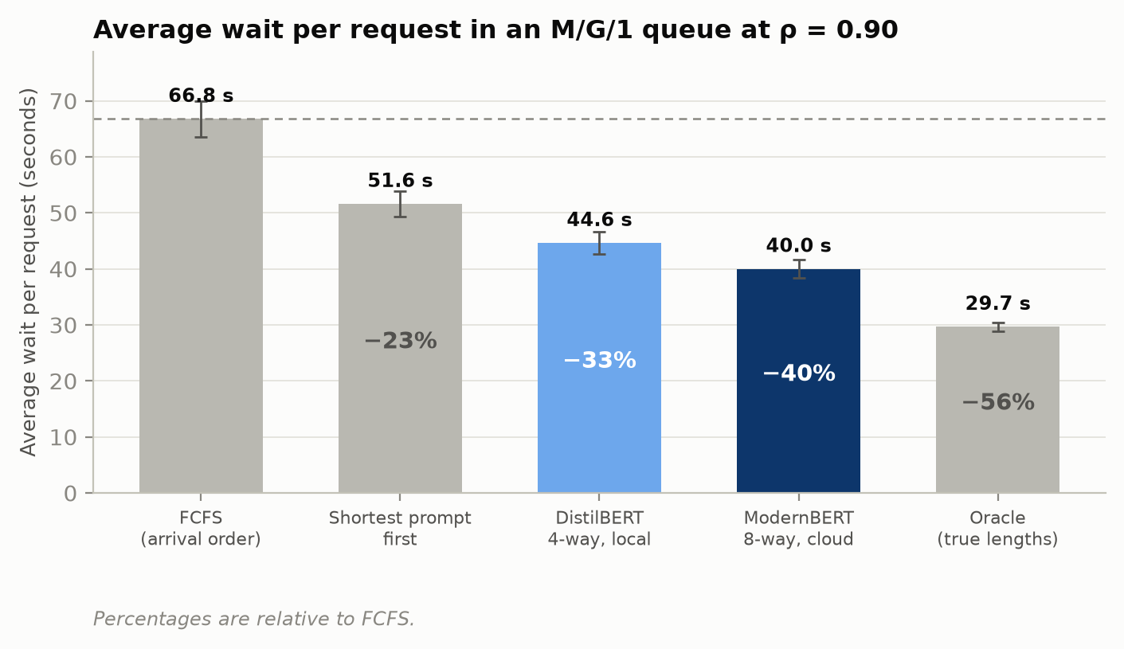
05 · APPLICATION
Finer buckets capture more of the oracle gain
−33%
−40%
−56%
DistilBERT vs FCFS · 60% of oracle
ModernBERT vs FCFS · 72% of oracle
Oracle
CS Workshop · Tel Aviv University · Gal Mund & Nadav Grossman
13 / 16
Notes:
Payoff. 4 buckets take 60% of oracle, 8 buckets take 72%. ~50 seconds.

Slide 14
06 · CLOSE
Limits
Data
Leakage
English, single-turn WildChat. Six GPT-3.5 / GPT-4 snapshots, not one model.
10,296 test prompts also appear in training.
Simulation
Fairness
One server, no batching. Not a live inference engine.
Predicted-Short waits 7 s; predicted-Very long waits 150 s.
CS Workshop · Tel Aviv University · Gal Mund & Nadav Grossman
14 / 16
Notes:
Honest close. Starvation is real. ~30 seconds.

Slide 15
06 · CLOSE
The prompt carries a usable length signal
H1
2.35× / 3.47× chance
Both models beat chance on equal-sized buckets.
H2
Not prompt length
A rule on prompt tokens reaches only 33% and 18%.
H3
60% → 72% of oracle
Finer buckets recover more of the true-length queue gain.
CS Workshop · Tel Aviv University · Gal Mund & Nadav Grossman
15 / 16
Notes:
Three hypotheses, three numbers. ~30 seconds.

Slide 16
Thank you
Questions
DistilBERT 58.7% · −33% wait
ModernBERT-large 43.4% · −40% wait
Gal Mund · 322544297 Nadav Grossman · 315111880
CS Workshop · Tel Aviv University · Gal Mund & Nadav Grossman
16 / 16
Notes:
Stop. Wait for questions.

